Slide 1
Introduction to Software Testing Lecture 11 Testing GUI Applications
Instructor: Morteza Zakeri
Initial version of slides by: Fatemeh Bakhshi
Completed and Modified by: Morteza Zakeri
March 2024

Slide 2
What is GUI Testing
Graphical User Interface (GUI) Testing
Methods used to identify and conduct GUI tests, including the use of automated tools.
How to test a GUI?
Manual: Resource intensive and Unreliable
Automated: Systematic method of test case generation
Elements of GUI Testing:
A process
A GUI Test Plan
A set of supporting tools
Most frequent GUI applications
Web applications

Slide 3
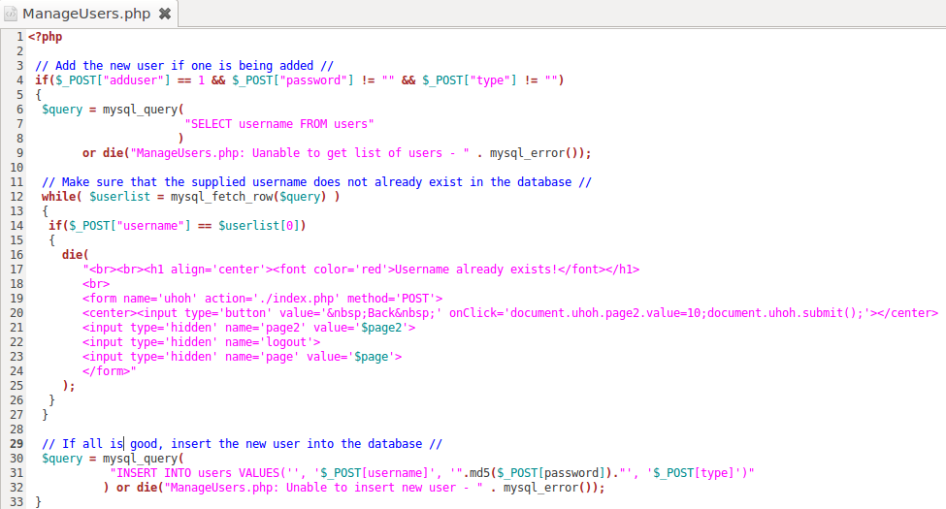
Uniqueness 1: Heterogeneous system
Server side
Can be written in PHP, Java, C#...
Communicate with Database server in SQL
PHP
PHP Script
SQL
HTML
SQL

Slide 4
Uniqueness 2: Dynamic pages
Client page is dynamic
It can change itself in the runtime
HTML can be modified by JavaScript
JavaScript can modify itself
Demo
Server script is dynamic
Client pages are constructed in the runtime
A same server script can produce completely different client pages
Demo
SchoolMate

Slide 5
Uniqueness 3: Performance
Performance is crucial to the success of a web app
Recall the experience to register for a class in the first days of the semester…
Are the servers powerful enough?
Performance testing evaluates system performance under normal and heavy usage
Load testing
For expected concurrent number of users
Stress testing
To understand the upper limits of capacity
Performance testing can be automated (Lecture 12)

Slide 6
Uniqueness 4: Security
Web applications usually deal with sensitive info, e.g.,
Credit card number
SSN
Billing / Shipping address
Security is the biggest concern
Security or penetration testing should simulate possible attacks
Security testing can be automated
Will be discussed in Lectures 13 and 14

Slide 7
Uniqueness 4: Security
SQL Injection
The untrusted input is used to construct dynamic SQL queries.
E.g., update my own password
$str = "UPDATE users SET password = \” “ . $_POST['newPass’] . “\” WHERE username =\”“ . $_POST['username'] . “\””;
mysql_query( $str );
PHP Script
$_POST['newPass’] = pass, $_POST['username'] = me
Query String: UPDATE users SET password = “pass” WHERE username =“me”
Normal Case
$_POST['newPass’] = pass, $_POST['username'] = “ OR 1=1 --
Query String: UPDATE users SET password = “pass” WHERE username =“” OR 1=1 --”
Attack

Slide 8
Uniqueness 4: Security
Cross Site Scripting (XSS)
The untrusted input is used to construct dynamic HTML pages.
The malicious JS injected executes in victim’s browser
The malicious JS can steal sensitive info
Solution: Never trust user inputs
Design test cases to simulate attacks.

Slide 9
User Interface (UI) functional tests
Run on an actual browser
Mimic the user actions in the application.
Give tester feedbacks on the integration between multiple components
Services, the UI, and the DB.
Are macro-level
Focus on validating all the critical user flows
One example of a critical user flow in the ecommerce application is searching for a product, adding the product to the cart, paying for the product, and getting an order confirmation.
Notes:
UI-driven functional tests are run on an actual browser and mimic the user actions in the application. These tests give us feedback on the
integration between multiple components, such as services, the UI, and the DB. These macro-level tests should focus on validating all
the critical user flows. One example of a critical user flow in the ecommerce application is searching for a product, adding the
product to the cart, paying for the product, and getting an order confirmation. This can be added as a UI functional test. When writing
such tests, avoid validating the same details covered as part of the lower-level micro tests again, as this will be redundant and increase
their execution time. For instance, verifying the order totals for different combinations of item prices should be covered by unit tests
and needn’t be validated again as part of a UI functional test. UI functional tests are usually kept apart from the application code
as a separate code base. They mainly come under the tester’s purview, although they may be jointly owned with developers. These
tests take longer to run and tend to be brittle, as they depend on the entire application stack’s behavior, including the infrastructure,
network, and so on, being stable. Additionally, they require considerable maintenance effort compared to other types of tests as
failures could happen anywhere across the entire application—for example, a change in an element ID, a delay in page load, or
unavailability of services due to environment issues. Tools like Selenium and Cypress are popularly adopted to write
automated UI tests. You’ll find exercises for both of them later in the chapter.
Resource: Full Stack Testing book (chapter 3)

Slide 10
UI functional tests vs. Unit tests
UI functional tests are macro-level tests.
Should focus on validating all the critical user flows.
When writing such tests, avoid validating the same details covered as part of the lower-level micro tests again.
This will be redundant and increase their execution time.
For instance, verifying the order totals for different combinations of item prices should be covered by unit tests and need not be verified again as part of a UI functional test.
UI functional tests are usually kept apart from the application code as a separate codebase.
Tools like Selenium and Cypress are popularly adopted to write automated UI tests.
Notes:
UI-driven functional tests are run on an actual browser and mimic the user actions in the application. These tests give us feedback on the
integration between multiple components, such as services, the UI, and the DB. These macro-level tests should focus on validating all
the critical user flows. One example of a critical user flow in the ecommerce application is searching for a product, adding the
product to the cart, paying for the product, and getting an order confirmation. This can be added as a UI functional test. When writing
such tests, avoid validating the same details covered as part of the lower-level micro tests again, as this will be redundant and increase
their execution time. For instance, verifying the order totals for different combinations of item prices should be covered by unit tests
and needn’t be validated again as part of a UI functional test. UI functional tests are usually kept apart from the application code
as a separate code base. They mainly come under the tester’s purview, although they may be jointly owned with developers. These
tests take longer to run and tend to be brittle, as they depend on the entire application stack’s behavior, including the infrastructure,
network, and so on, being stable. Additionally, they require considerable maintenance effort compared to other types of tests as
failures could happen anywhere across the entire application—for example, a change in an element ID, a delay in page load, or
unavailability of services due to environment issues. Tools like Selenium and Cypress are popularly adopted to write
automated UI tests. You’ll find exercises for both of them later in the chapter.
Resource: Full Stack Testing book (chapter 3)

Slide 11
UI functional tests vs. End-to-end tests
End-to-end tests should validate the entire breadth of your domain workflow, including downstream systems.
Mimic the user actions in the application.
Depending on the application context, the UI functional tests often tend to become end-to-end tests.
If not, create separate end-to-end tests using a combination of UI, service, and DB testing tools to cover the entire integration flow.
System and integeration testing
These tests take the longest time to run and require more care in maintaining, as they need a stable environment and test data setup across various systems.
Just setup a few test scenarios that will activate all your components.
Notes:
End-to-end tests should validate the entire breadth of your domain workflow, including downstream systems. In the ecommerce application, after an order is placed on the website, the downstream systems (such as the warehouse management system, third-party shipping partner services, and so on) actually fulfill the order. This end-to-end domain flow needs to be tested for proper integration. Depending on the application context, the UI functional tests often
tend to become end-to-end tests. If not, create separate end-to-end tests using a combination of UI, service, and DB testing tools to cover the entire integration flow. Obviously, these tests take the longest time to run and require more care in maintaining, as they need a stable environment and test data setup across various systems. The intent of these tests is to determine whether all the components are integrated properly end to end, and not to test the
components’ functionalities. So, you can just have a few tests that will activate all your components.
Resource: Full Stack Testing book (chapter 3)

Slide 12
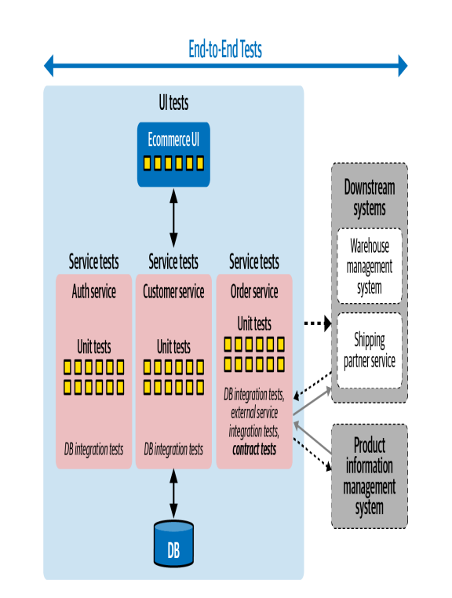
UI functional tests
VS.
End-to-end tests
VS.
Unit tests
Notes:
Resource: Full Stack Testing book (chapter 3)

Slide 13
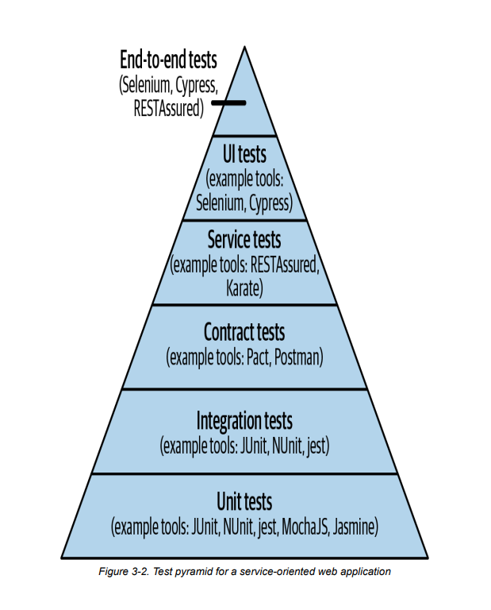

Test pyramid for a (service-oriented) web application
Notes:
Mike Cohn crystallized this nicely with a visual cue in his 2009 book Succeeding with Agile (Addison-Wesley Professional) as the test pyramid concept. The test pyramid recommends having a broad bucket of micro-level tests and gradually reducing the number of macro-level tests as their scope increases. For example, if you have 10x unit and integration tests, you should have 5x service tests and only x UI-driven tests. If you layer these one on top of another, with the unit tests at the bottom, they form a pyramid. The obvious reason for such a recommendation is that as the scope of the tests increases, they take more time to run and cost more to write and maintain
a few E2E tests will activate all your components
Although the test pyramid can be thought of as the ideal to pursue, there may be situations where it is not possible to achieve a true pyramid shape. This can be due to practical pitfalls, such as lack of a fully deployed test environment to support end-to-end tests, or lack of tools to automate certain kinds of functionalities (such as barcode scanning), or, bluntly, lack of skills. In such cases, the team should be mindful of the trade-offs they are making and choose the quantity and types of tests in such a way that they can still achieve the goal of getting fast feedback, despite these constraints.
Resource: Full Stack Testing book (chapter 3)

Slide 14
Automated tests vs. Manual tests
Manual tests | Automated tests
Requires human intervention. | Use tools to inject and execute tests.
Requires skilled labor, long time and costs. | Save manpower, times, and cost
Any type of application can be tested. | Recommended only for stable systems.
Can become repetitive and boring. | Boring part of execution handled by tools.

Slide 15
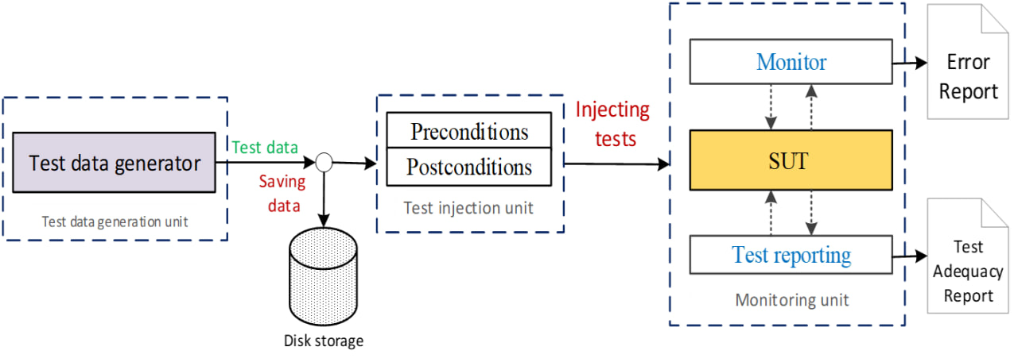
Test automation
Test data generation
➔Test injection
Monitoring and report

Slide 16
Test from the front end
Good things
Hide the complexity of the backend
Uniformed interface
Can put a robot in the front end and automate the tests
Bad things
The front end is not trustable
Crafted malicious requests
Front end limits the length of the input values
Front end limits the content of the input values
Front end limits the combination of the input values

Slide 17
Good things of testing from the front end
Automated web app testing
Compare to commend-line program testing…
GUI testing: event driven (the difference)
“Button A” then “Button B” → OK
“Button B” then “Button A” → FAIL
Sensitive to input values (the same)
The robot should be able to
Provide input values
Simulate user actions

Slide 18
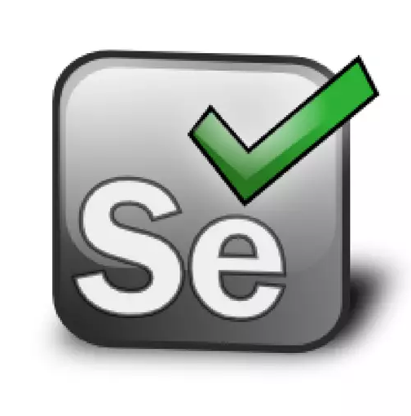
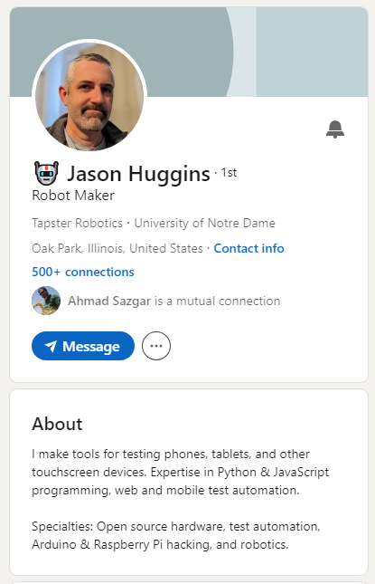
Selenium
An open source automated testing tool for web application.
Jason Huggins building the Core mode as "JavaScriptTestRunner" in 2004.
Paul Hammant saw the demo, and started discussions about the open sourcing of Selenium.
Notes:
The story starts in 2004 at ThoughtWorks in Chicago, with Jason Huggins building the Core mode as "JavaScriptTestRunner" for the testing of an internal Time and Expenses application (Python, Plone). Automatic testing of any applications is core to ThoughtWork's style, given the Agile leanings of this consultancy. He has help from Paul Gross and Jie Tina Wang. For them, this was a day job. Soon after in 2004 fellow ThoughtWorker Paul Hammant saw the demo, and started discussions about the open sourcing of Selenium

Slide 19
What Selenium can do
A solution for the automated testing
Simulate user actions as a web bot (This lecture)
Functional testing (This lecture)
Create regression tests to verify functionality and user acceptance.
Performance Testing (Lecture 12)
Load testing
Stress testing
Browser compatibility testing
The same script can run on any Selenium platform

Slide 20
Selenium main features
Open source.
Supports many languages (Python, C#, Javascript, … ).
Suppurts many browsers (Firefox, Chrome, …).
Supports many operating systems.
Flexible.

Slide 21
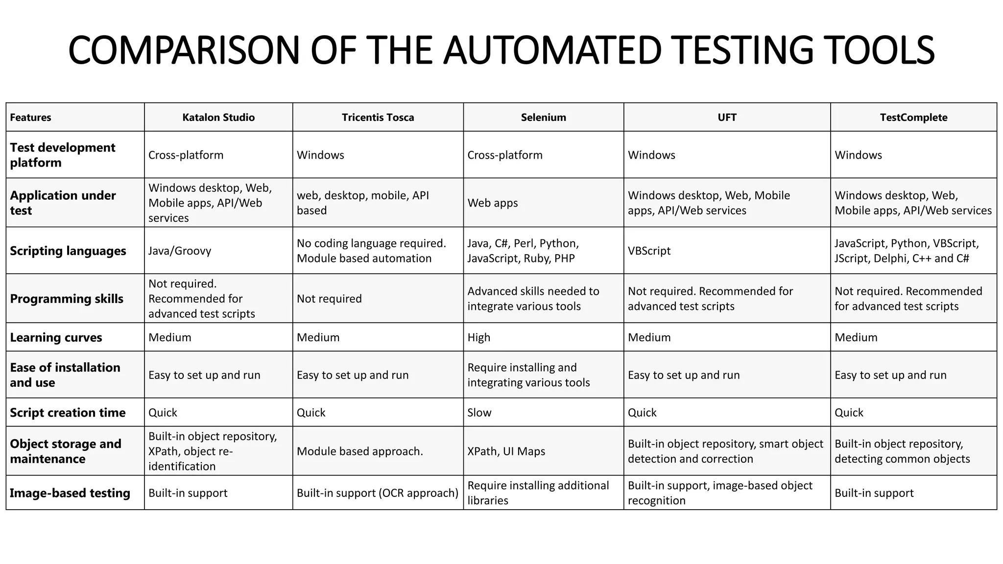
GUI Test Automation Tools

Slide 22
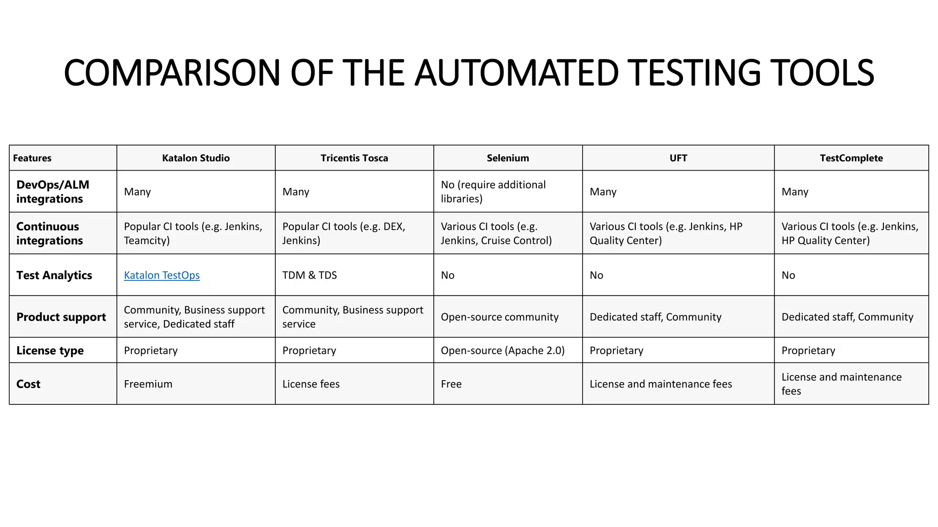
GUI Test Automation Tools
Comparison of product features

Slide 23
Selenium Components
Selenium integrated development environment (IDE)
Selenium remote control (RC)
Webdriver
Selenium Grid
Selenium Action API (Python, Javascript, …)

Slide 24
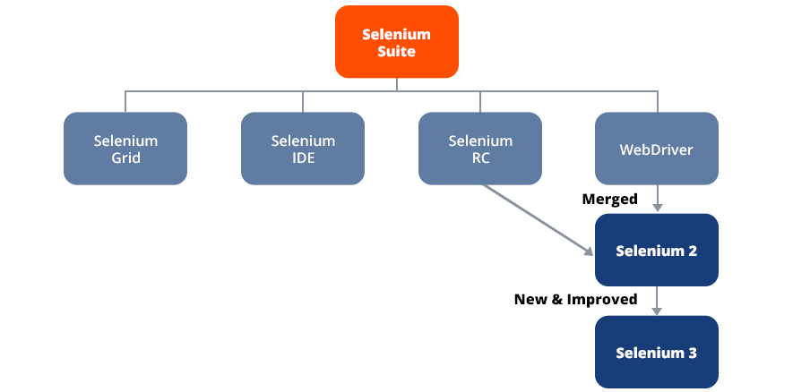
Selenium Components
Selenium integrated development environment (IDE)
Selenium remote control (RC)
Webdriver
Selenium Grid
Selenium Action API (Python, Javascript, …)

Slide 25
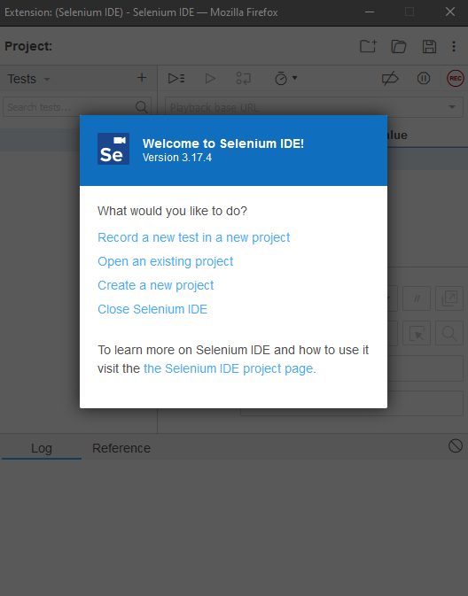
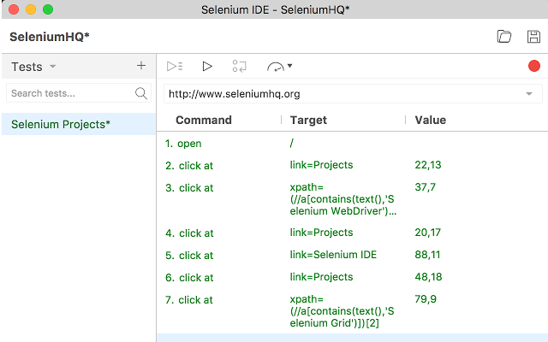
Selenium IDE
Firefox and Chrome extension.
Easy record and replay.
Debug and set breakpoints.
Selenium Grid
https://www.selenium.dev/selenium-ide

Slide 26
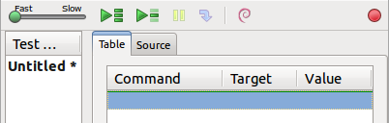
Selenium IDE test cases
Selenium saves all information in an HTML table format
Each record consists of:
Command – tells Selenium what to do (e.g., “open”, “type”, “click”, “verifyText”)
Target – tells Selenium which HTML element a command refers to (e.g., textbox, header, table)
Value – used for any command that might need a value of some kind (e.g., type something into a textbox)

Slide 27
How to record/replay with Selenium IDE
Start recording in Selenium IDE
Execute a test scenario on running web application
Stop recording in Selenium IDE
Verify / Add assertions
Replay the test.
Selenium IDE Demo …

Slide 28
Limitation of Selenium IDE
No multiple browsers support
It currently runs in Mozilla Firefox and Google Chrome.
No manual scripts
E.g., conditions and Loops for Data-Driven Testing
Fancy test cases → Selenium WebDriver

Slide 29
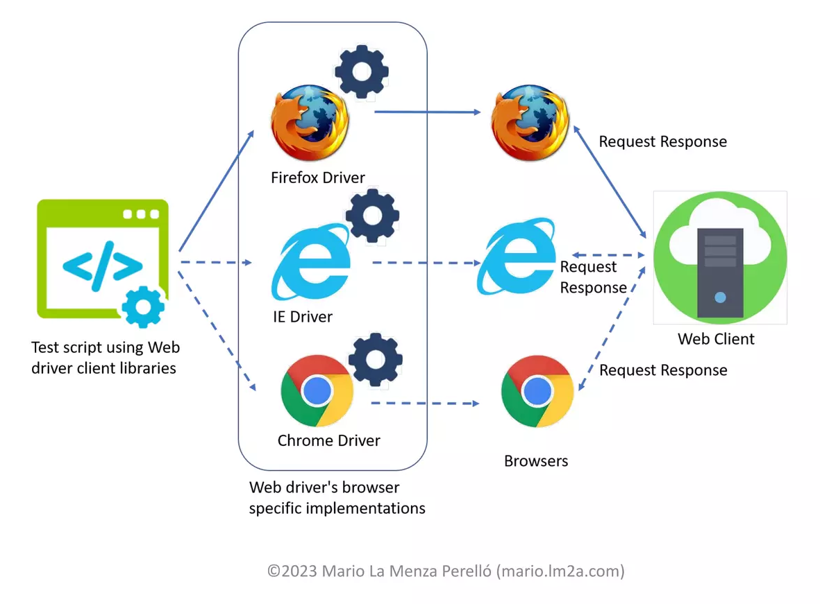
Selenium Webdriver
Webdriver is a browser automation framework that accepts commands and sends them to browsers.

Slide 30
Selenium WebDriver (Selenium 2)
Selenium-WebDriver
A piece of program
Control the browser by programming
More flexible and powerful
Selenium-WebDriver supports multiple browsers in multiple platforms
Google Chrome 12.0.712.0+
Internet Explorer 6+
Firefox 3.0+
Opera 11.5+
Android – 2.3+ for phones and tablets
iOS 3+ for phones
iOS 3.2+ for tablets

Slide 31
Selenium WebDriver
WebDriver is designed to providing a simpler and uniformed programming interface
Control Web Browser by programming
Same WebDriver script runs for different platforms
Support multiple programming language:
Java, Javascript, C#, Python, Ruby, PHP, Perl…
It is efficient
WebDriver leverages each browser’s native support for automation.

Slide 32
Selenium Webdriver
A separate test program/ application
Supports multiple browsers in multiple platforms
Chrome,
Firefox,
Opera,
Internet explorer,
Andriod,
iOS.

Slide 33
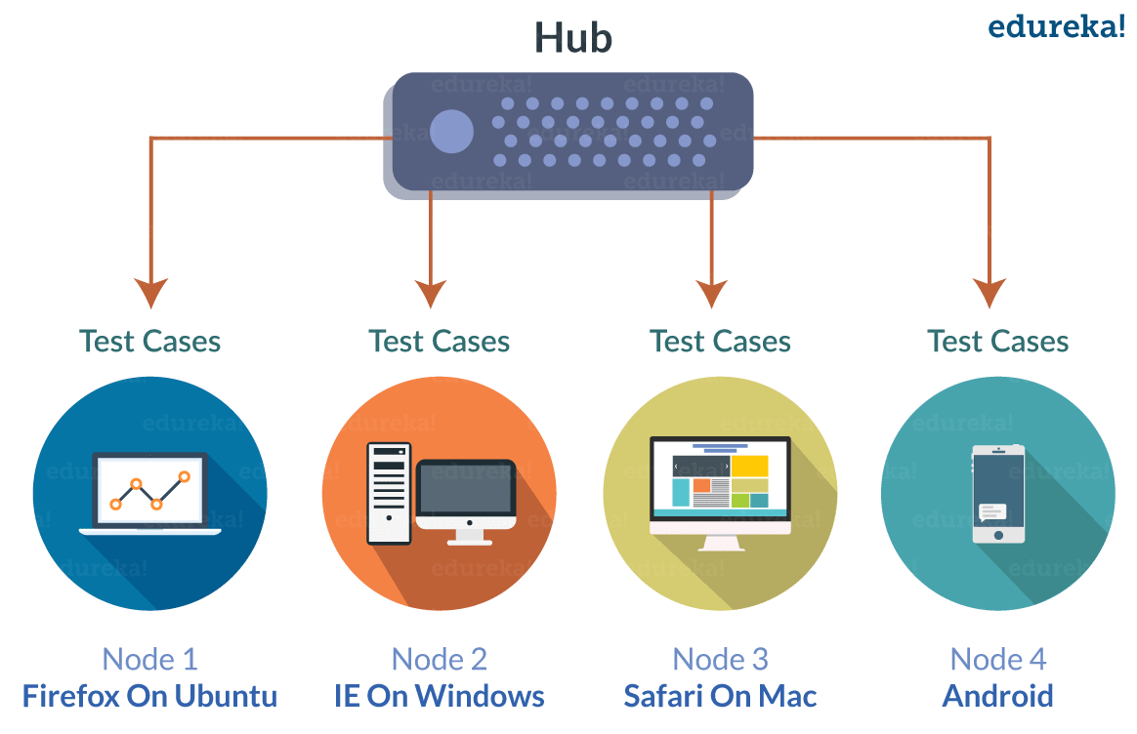
Selenium Grid
Distributed test execution on several machines

Slide 34
Writing UI Functional Tests with Selenium

Slide 35
How to use Selenium WebDriver
(1) Go to a page
(2) Locate an element
(3) Do something with that element
......
(i) Locate an element
(i+1) Do something with that element
(i+2) Verify / Assert the result

Slide 36
Web Element
Anything presented in webpage (front-end)
Box
Labels
Button
Dropdown

Slide 37
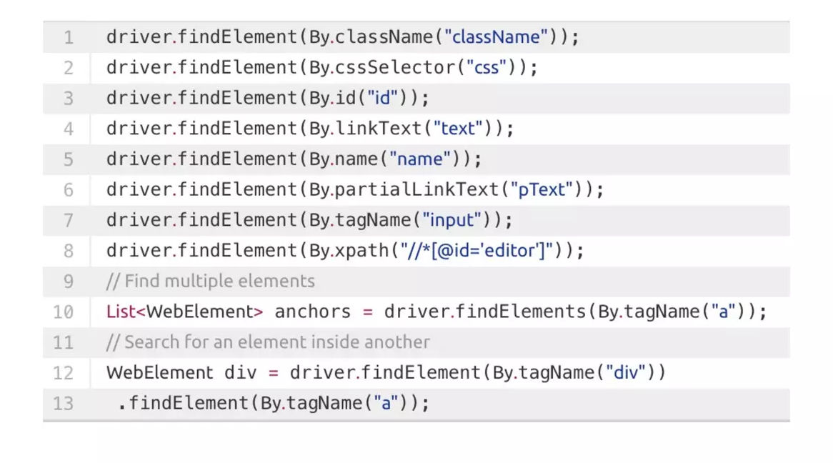
Web element
They are identified by locators
id
name
class
xpath

Slide 38
Example 1: Verify page title
public static void main( String[] args )
{
// Create a new instance of the Firefox driver
WebDriver driver = new FirefoxDriver();
// (1) Go to a page
driver.get("http://www.google.com");
// (2) Locate an element
WebElement element = driver.findElement(By.name("q"));
// (3-1) Enter something to search for
element.sendKeys("Purdue Univeristy");
// (3-2) Now submit the form. WebDriver will find the form for us from the element
element.submit();
// (3-3) Wait up to 10 seconds for a condition
WebDriverWait waiting = new WebDriverWait(driver, 10);
waiting.until( ExpectedConditions.presenceOfElementLocated( By.id("pnnext") ) );
// (4) Check the title of the page
if( driver.getTitle().equals("purdue univeristy - Google Search") )
System.out.println("PASS");
else
System.err.println("FAIL");
//Close the browser
driver.quit();
}

Slide 39
How to locate an element
By id
HTML: <div id="coolestWidgetEvah">...</div>
WebDriver:
driver.findElement( By.id("coolestWidgetEvah") );
By name
HTML: <input name="cheese" type="text"/>
WebDriver: driver.findElement( By.name("cheese") );
By Xpath
HTML
<html>
<input type="text" name="example" />
<input type="text" name="other" />
</html>
WebDriver: driver.findElements( By.xpath("//input") );
There are plug-ins for firefox/chrome to automatically display the Xpath

Slide 40
Time issue
There are delays between submitting a request and receiving the response
We can wait until the response page is loaded
Robot does not know!
In WebDriver, sometimes it doesn’t work if
Submit a request
Verify the response immediately
Solution:
Simulate the wait. Wait until some HTML object appears
Demo

Slide 41
Example 1: Verify page title
public static void main( String[] args )
{
// Create a new instance of the Firefox driver
WebDriver driver = new FirefoxDriver();
// (1) Go to a page
driver.get("http://www.google.com");
// (2) Locate an element
WebElement element = driver.findElement(By.name("q"));
// (3-1) Enter something to search for
element.sendKeys("Purdue Univeristy");
//(3-2) Now submit the form.
//WebDriver will find the form for us from the element
element.submit();
// (3-3) Wait up to 10 seconds for a condition
WebDriverWait waiting = new WebDriverWait(driver, 10);
waiting.until( ExpectedConditions.presenceOfElementLocated(By.id("pnnext")));
// (4) Check the title of the page
if( driver.getTitle().equals("purdue univeristy - Google Search") )
System.out.println("PASS");
else
System.err.println("FAIL");
//Close the browser
driver.quit();
}

Slide 42
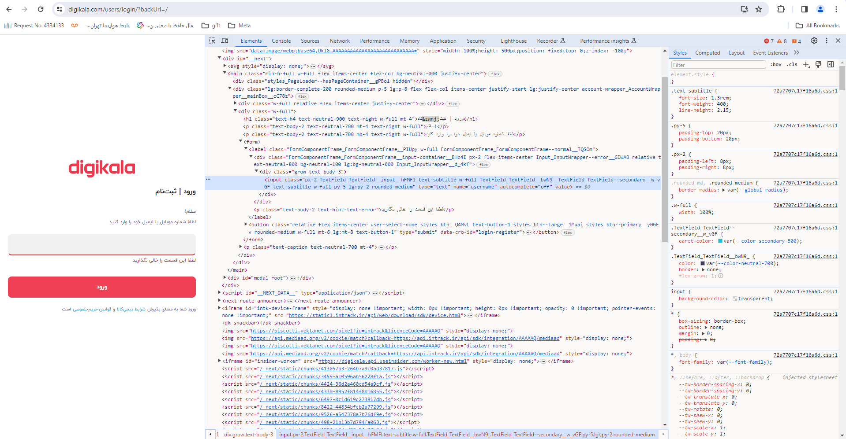
Example 2: Test Digikala login feature
Digikala login page elements

Slide 43
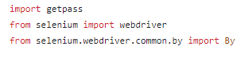
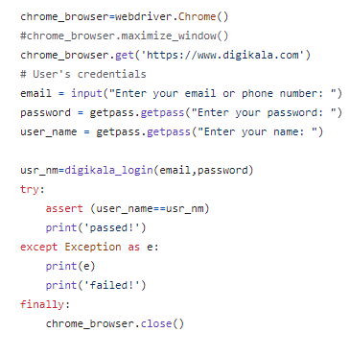
Example 2: Test Digikala login feature

Slide 44
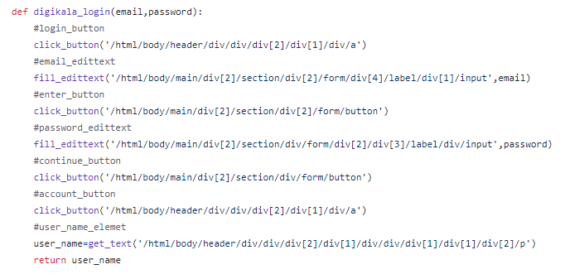
Example 2: Test Digikala login feature
Complete source code: https://github.com/FtmhBkhsh/Test

Slide 46
More tools
Katalan
https://katalon.com/

Slide 47
GUI Testing Assignment

Slide 48
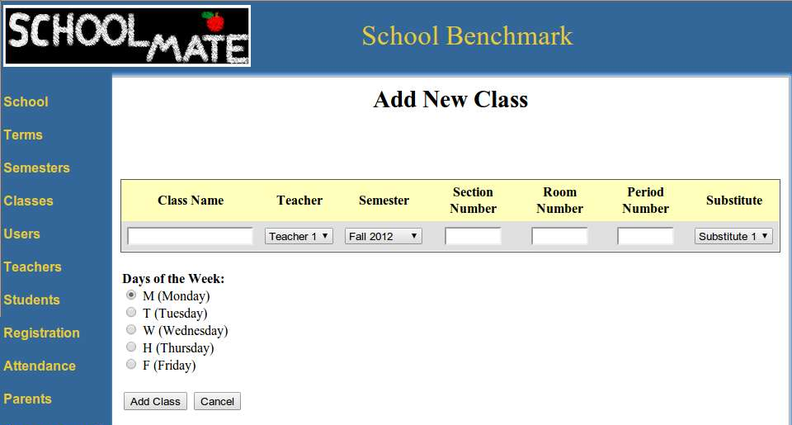
GUI Testing Assignment
Test a functionality without the source
The subject web application
“Add New Class” in “SchoolMate”

Slide 49
GUI Testing Assignment: Part 1
Part 1: Overview
Design test cases against the requirement
The tests should consider
all possible cases
equivalence class partitioning
Implement Selenium WebDriver Script for “Add new class”
Your test cases
Your WebDriver test template
Test
results
input
output

Slide 50
Part 1: requirement analysis
Requirement for values entered/selected
[R-1] Class Name : alphabets and numbers are allowed.
[R-2] Section Number : only numbers are allowed.
[R-3] Room Number : only numbers are allowed.
[R-4] Period Number : only numbers are allowed.
[R-5] All textbox fields : no Cross-Site Scripting (XSS) injection vulnerabilities.

Slide 51
Part 1: requirement analysis
Requirement for the “add” function
After clicking the “Add class” button…
[R-6] The class record added is successfully shown in the table.
[R-7] The values are exactly the same as those were entered or selected.

Slide 52
Part 1: Design testcases
For each requirement, design test cases
Only need test one field in each case
Do not need consider combinations of fileds
E.g.
[R-1] Class Name : alphabets and numbers are allowed.
You need consider all possible cases
Divide the test space and find the equivalence class
Alphabets
Numbers
….
The test case format is defined
Test cases will be used as input to your WebDriver Script

Slide 53
Part 1: Implement WebDriver Script
In WebDriver script, Simulate the user action
Navigate to the subject page
Enter values into textboxs based on input values
Select options based on input values
Click the “add class” button
Check the result against the requirements
Run all your test cases and report the results.

Slide 54
GUI Testing Assignment: Part 2
Part 2: Pair wise testing
Use an existing pair wise testing tool fire-eye
Largely you may reuse the WebDriver template in Part 1
Test cases generated
Convert
Your test cases
Your WebDriver test template
Test
result
input
output

Slide 55
Part 2: Generate test cases
Consider the combination of all textboxs/options
Use the existing tool, fire-eye, to generate test cases
Export the test case in “Nist form”
Parse and convert the exported test cases to the form that your WebDriver can accept.
Run all pair-wise test cases.
Report the results.

Slide 56
GUI Testing Assignment: Part 3
Solution Design
Selenium can do more …
Black Friday is coming, hot items can be sold in a few seconds
Can you leverage the automated tool and design a practical solution to score a super hot deal?
Explain
What is the challenge
What is the possible cases to handle and how?
In stock
Out of stock
Your shopping cart may be reset under what conditions…
How to add it into your shopping cart asap
How you are going to cooperate with the automated tool

Slide 57
GUI Testing Appendix:
Automatic test data/case generation for GUI Apps

Slide 58
Test automation
➔ Test data generation
Test injection
Monitoring and report

Slide 59
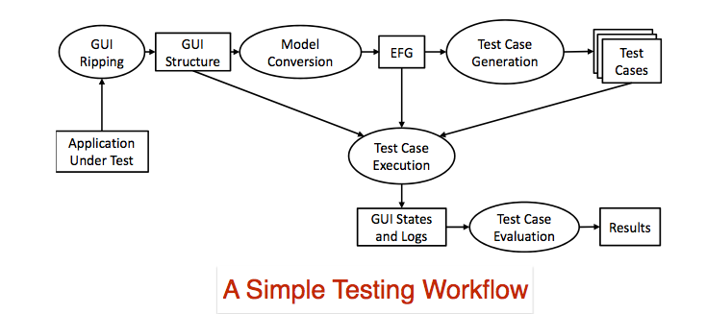
Automated GUI Test data generation
GUITAR
A GUI testing framework (https://sourceforge.net/projects/guitar/)
Nguyen, B.N., Robbins, B., Banerjee, I. et al. GUITAR: an innovative tool for automated testing of GUI-driven software. Autom Softw Eng 21, 65–105 (2014). https://doi.org/10.1007/s10515-013-0128-9

Slide 60
Automated GUI Test data generation
GUITAR contains four parts:
The GUIRipper
Used to extract GUI information from a program.
The GUIStructure2Graph
Uses this output to build a traversable graph representation of the GUI elements.
The TestCaseGenerator
Creates an extensive set of test cases based on the graph.
The GUIReplayer
Runs the program as instructed by these tests.

Slide 61
GUITAR Recap
JFC Ripper
GUI Structure
2 EFG
Testcase
Generator
JFC Replayer
Notes:
61

Slide 62
TCG Plugin Structure
TestCaseGenerator Core
Sequence
Length
Coverage
Random
Test Case
Custom
Plugin
Notes:
62

Slide 63
GUITAR Test Case Generator (TCG)
Generates test cases given two inputs:
Formal model of the GUI in the form of a Graph
Graph traversal algorithm to simulate a user’s possible interactions with the GUI
Event Flow Graph (EFG)
Bundled plugins
Sequence Length
Random

Slide 64
TCG Demo
Test case generator arguments:
Output.dir
EFG
Plugin
Length
Max-number
These arguments can be changed in the TestCaseGenerator.properties file

Slide 65
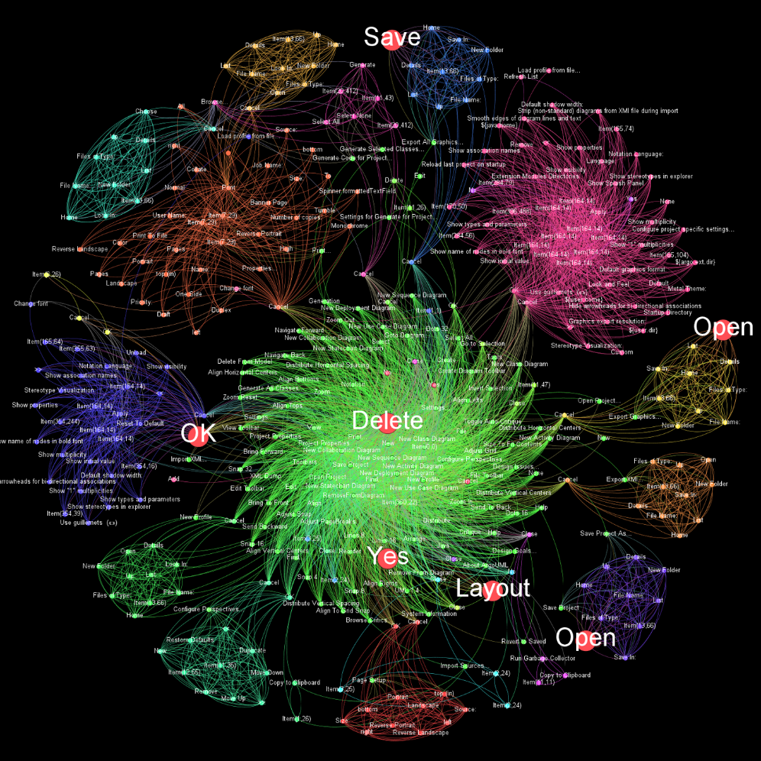
Sequence Length Plugin Demo
Looking at a sequence generated:
<?xml version="1.0" encoding="UTF-8" standalone="yes"?>
<TestCase>
<Step>
<EventId>e16</EventId>
<ReachingStep>false</ReachingStep>
</Step>
<Step>
<EventId>e18</EventId>
<ReachingStep>false</ReachingStep>
</Step>
<Step>
<EventId>e39</EventId>
<ReachingStep>false</ReachingStep>
</Step>
</TestCase>

Slide 66
WeightedRandom Plugin Demo
Takes as input an EFG representing the graph structure and an EFG representing the weights of edges.
Generates shortest path test cases for each potential starting event to every reachable event.
Rest of tests generated by picking starting event and rest of path randomly, weighted by out edges.
Notes:
WeightedRandom is another plugin we’ve included with the TestCaseGenerator tool.
WeightedRandom takes as input an EFG file representing the event flow’s graph structure,
and an EFG file containing the weights of edges from that graph.
This plugin generates two sets of test: one set containing tests following the shortest path of every
potential starting event to all events it can reach and another set of tests that are generated at random
with higher precedence going to edges leading to events with a low sum of out edges.
66

Slide 67
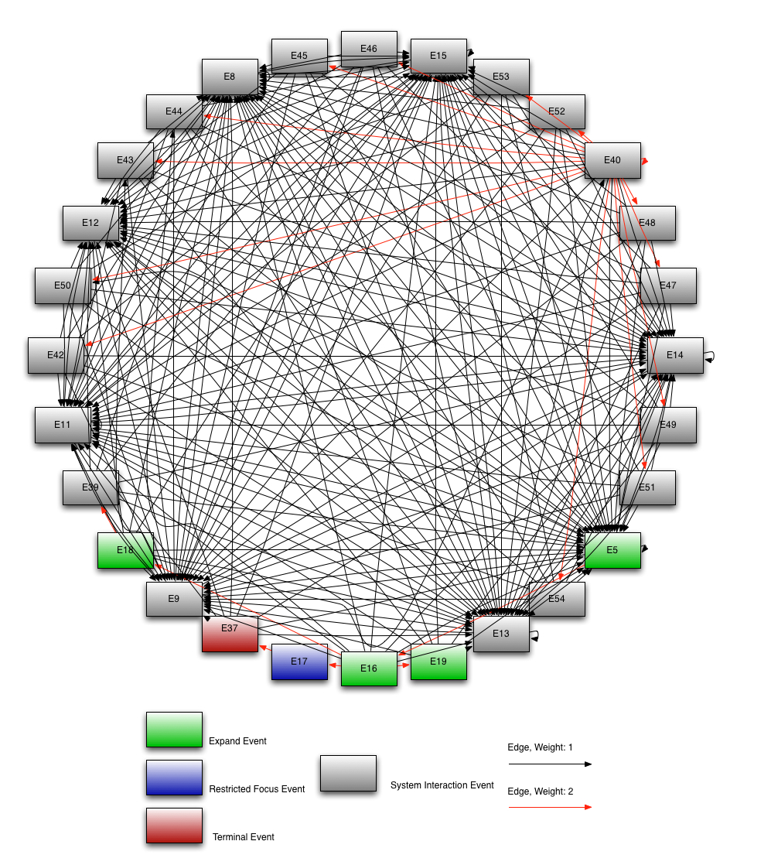
Notes:
The WeightedRandom plugin comes in handy when developers desire some degree of
control over a large set of potential tests. Dense event flow graphs like the following cannot
provide total path coverage in testing, therefore randomization is desirable to generate tests so
paths are not cherry-picked by developers.
WeightedRandom enhances this process by accepting weighted edges in event flow graph, which
can be hand generated for tricky/buggy events, produced from empirical data on how an interface is
commonly used, or according to other criteria.
67

Slide 68
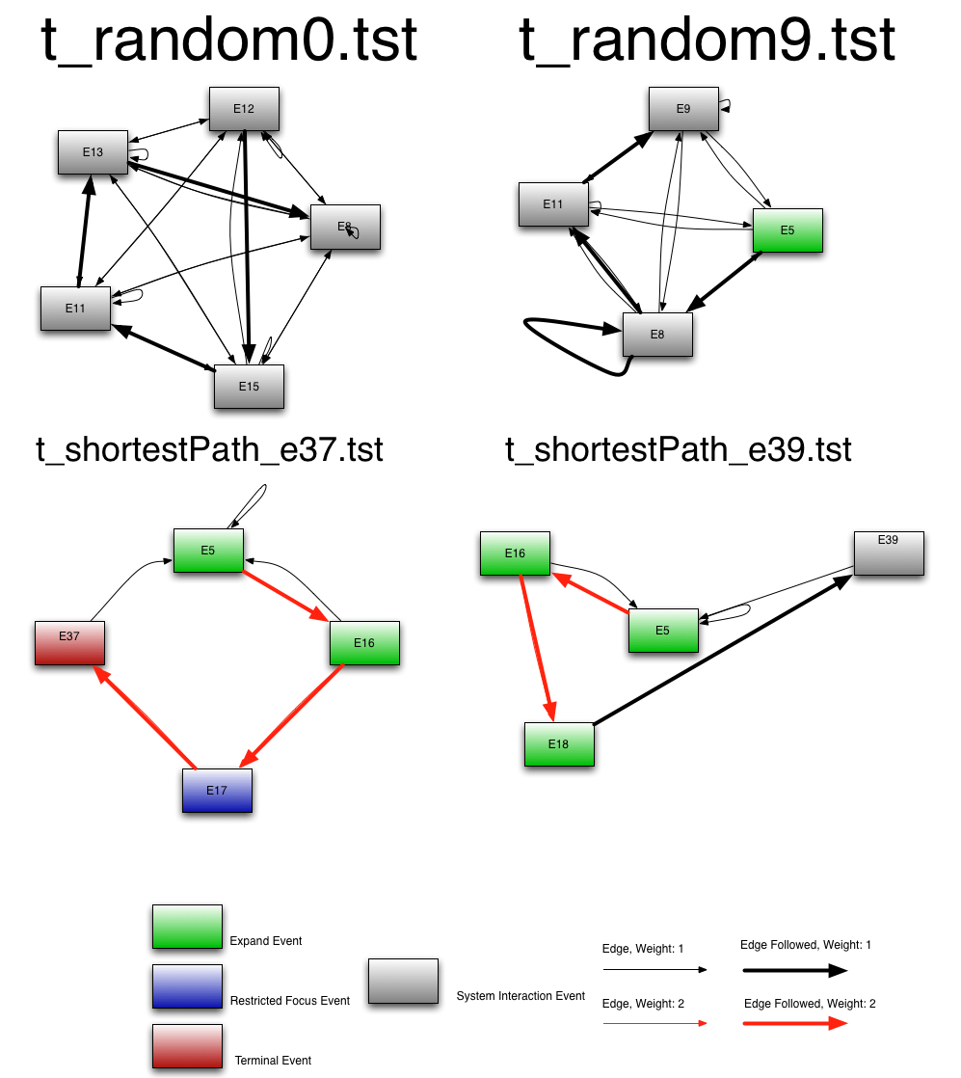
Example Test Cases
Notes:
Here are example test cases generated from a previous run of this plugin with max length set to be 5.
The top two test cases are from the randomly generated test cases and the bottom two are from the
shortest path test cases.
As you can see, these test cases span at most 5 nodes each. The random test cases appear to follow
edges leading to events that have the highest sum of out edges, but does so randomly as t_random9.tst
Illustrates on event E8 where two edges are taken on two different visits to E8.
The shortest path test cases are also generated to spec, as none of the test cases form loops and the shortest
path to the destination event is always taken.
68

Slide 69
An EFG
e0
e1
e2
e3
e4
Notes:
69

Slide 70
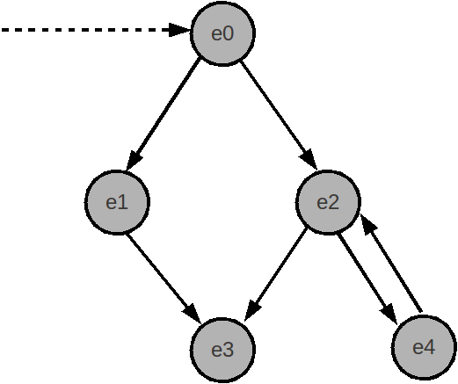
A Graph Traversal (SequenceLengthCoverage)
Testcases:
e0 → e2 → e4
e0 → e2 → e3
Notes:
70

Slide 71
Another Graph Traversal (Random)
Testcases:
e0 → e1 → e3
e0 → e2 → e4
Notes:
71

Slide 72
Plugin Goals
TestCaseGenerator uses this plugin mechanism due to different goals in graph traversal:
Speed: Complete coverage plugins may be infeasible for larger graphs
Completeness: For smaller GUIs, all possible test cases may be preferred
Focus: Specific types of test cases, e.g. “All test cases with no cycles”
Notes:
72

Slide 73
Plugin Implementation
GUITAR TestCaseGenerator plugins are based off the TCPlugin abstract class
public abstract class TCPlugin
* generate(EFG efg, String outputDir, int nMaxNumber)
* getConfiguration()
* isValidArgs()
* writeToFile(String tCName, LinkedList<EventType> path)
* initialize()
* getPathToRoot(EventType event)
Notes:
73

Slide 74
Plugin Implementation (ctd)
TCG events are broken down into three types:
Successors
Predecessors
Initial Events
1
2
3
Notes:
74

Slide 75
Relevant GUITAR Constants
NO_EDGE: There is no relationship between the two events
FOLLOW_EDGE: Typical edges in a graph
REACHING_EDGE: Edges used to reach an event
Notes:
75

Slide 76
initialize()
e0
FOLLOW_EDGE
e1
e2
REACHING_EDGE
e3
e4
Notes:
76

Slide 77
initialize()
initialEvents: {e0}
e0
preds: {e0 → Ø}
{e1 → Ø}
{e2 → e0, e4}
{e3 → e2}
{e4 → Ø}
succs: {e0 → e1, e2}
{e1 → e3}
{e2 → e3, e4}
{e3 → Ø}
{e4 → e2}
e1
e2
e3
e4
Notes:
77

Slide 78
getPathToRoot(EventType event)
e0
Paths to Root -
e0 : e0
e1 : Ø
e2 : e0 → e2
e3 : e0 → e2 → e3
e4 : Ø
e1
e2
e3
e4
Notes:
78

Slide 79
Configuration
In many cases, additional arguments are needed for a TestCaseGenerator plugin.
Plugins can override a “getConfiguration” method in the TCPlugin interface.
The configuration specifies which additional arguments are to be parsed from the command line.
Notes:
79

Slide 80
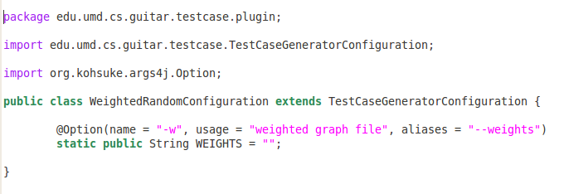
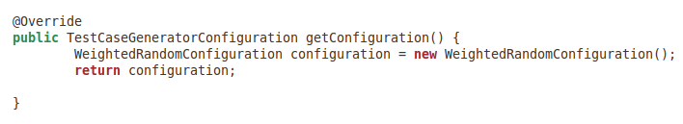
Example: Weighted Random Configuration
Configuration Class File:
Implementation of getConfiguration() in WeightedRandom.java:
Notes:
80

Slide 81
Relevant Java Imports
org.kohsuke.args4j
Useful command line parser that contains
An “Option” object, which acts as a field/setter that receives a command line switch value.
Notes:
81

